Slide 1
Basic Training for Uploading Patients
June 2024

Slide 2
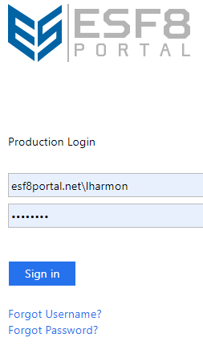
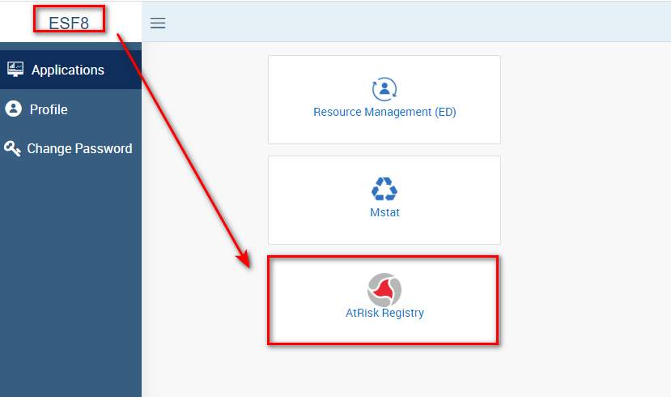
Logging in to the AtRisk Registry - Users must have a login for the ESF8 PORTAL
Once Logged in, choose the AtRISK Registry icon to begin.

Slide 3
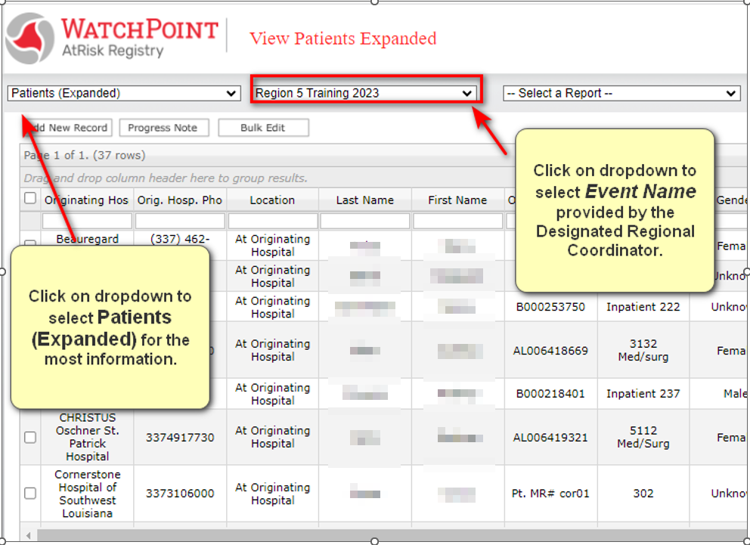
Event Verification and Downloading the Latest Template
Always check the Event Name and for the latest template in the registry.

Slide 4
Download to a folder you can find or your desktop!
The template will download at bottom of the screen:

Slide 5
Priority Fields: Align with Attachment A of the user guide.
Several fields are self explanatory and can be cut and pasted using the EPIC download file, if that process is automated for your facility:
Last Name
First Name
Medical Record Number
Gender
History – includes information such as dialysis and medical equipment dependencies
Room number – unit type + room #
Weight (defaults to lbs.)
DOB
Diagnosis – including vent, cardiac monitor or other electric devices
Disposition – this will default to “Shelter in Place” and can be managed individually or in bulk after initial upload
Reminder! Save your completed file in an easily remembered file. Suggestion, save it to “Desktop”.

Slide 6
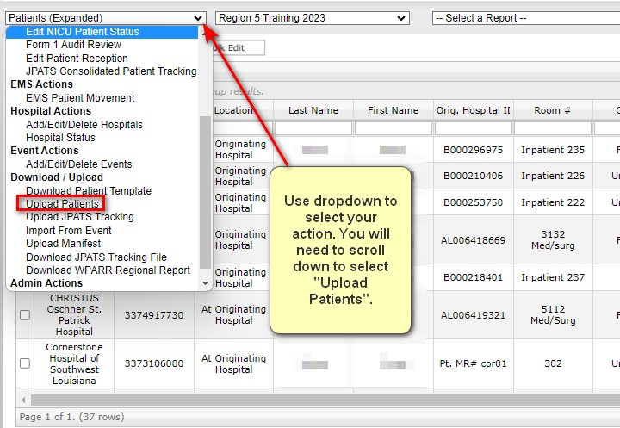
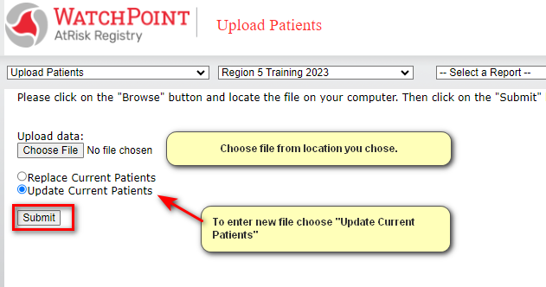
Uploading Patient Census

Slide 7
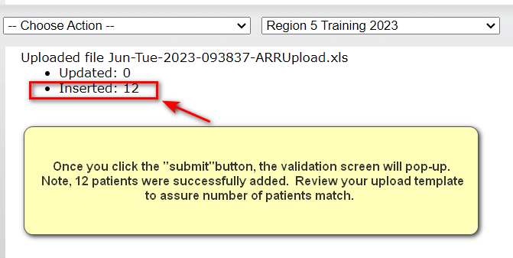
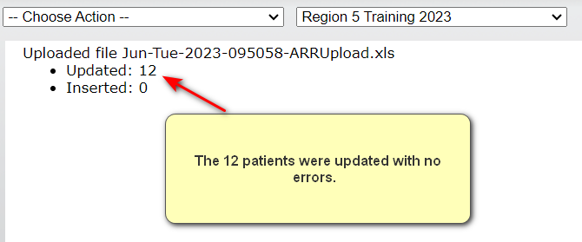
Validating Upload
Initial Upload:
Changes made to initial patients, uploaded patient template again “Update Current Patients” selected:
NOTE:
“Update Current Patients” will update data in fields in previously uploaded patients.
“Replace Current Patients” will replace the ENTIRE file.

Slide 8
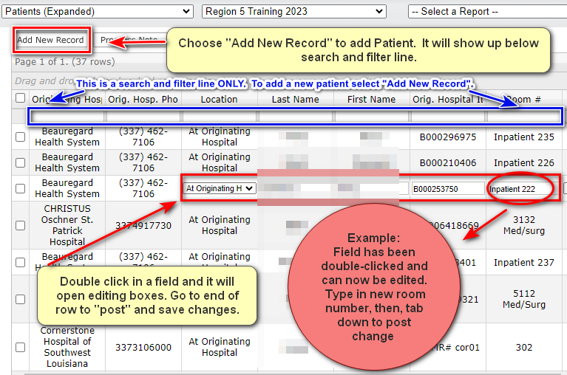
Editing Individual Patient Information / Searching and Filtering
You must always scroll to the end of the row to post changes!

Slide 9
In-State Movement Specifications
Applies to:
Movement within systems
Transfers according to hospital plans
State and DRC Assisted placement

Slide 10
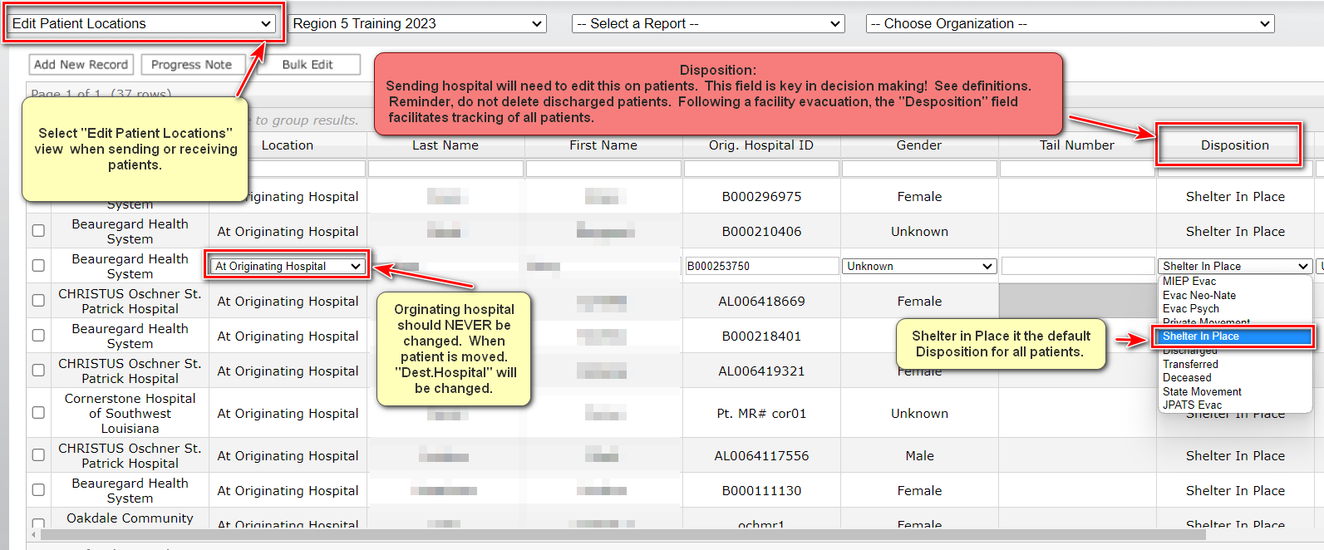
In-State Patient Movement

Slide 11
Disposition Definitions: Aligns with Attachment C of the User Guide
Evac Neonate – Private contracts with Women’s or other NICU centers
Evac Psych – Admitted psychiatric patients needing in-state placement using state/DRC assistance.
Private Movement – You are going outside your system with the patient-NO ASSISTANCE FROM STATE
Discharged – Most of these will be your ED folks, and others as applicable
Transferred – Patient moved within your system – NO ASSISTANCE FROM STATE
State Movement – ESF8 is facilitating movement. DRC is locating destination and EMS-DRC is coordination transportation.
Notes:
We’ll need to update this after Friday’s workshop to make sure it’s consistent and what we’ve all decided on. Will align with what’s in updated Attachment D. Need to include what screen(s) these options appear on – should be included in previous slide.

Slide 12
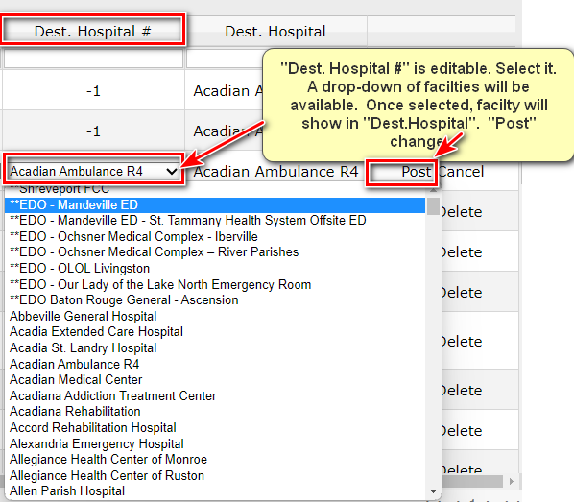
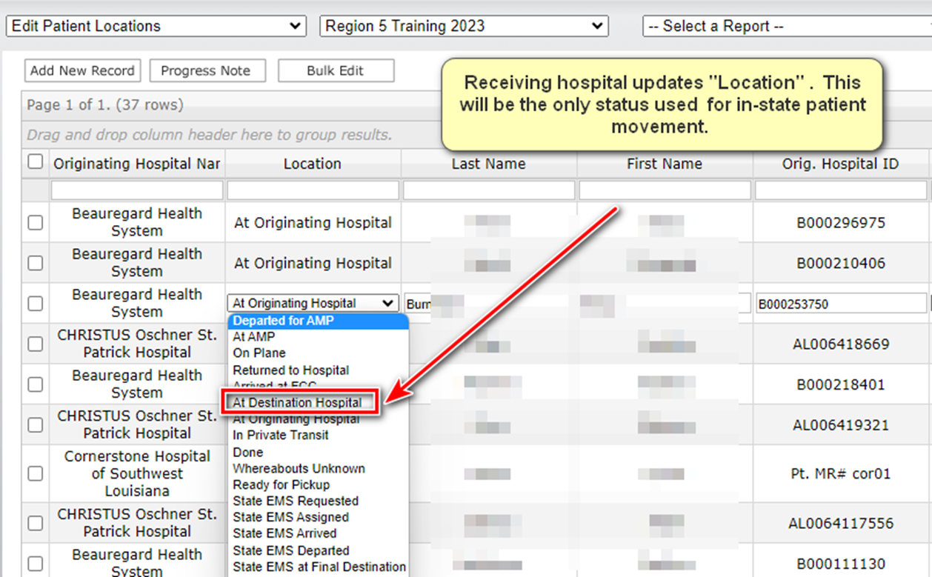
In-State Patient Movement –State/DRC assisted Movement
Assumption: The hospital plan has failed, State/DRC locates beds and arranges transportation.
Sending Hospital or DRC will make change to “Dest. Hospital”. Once the change is posted, the receiving hospital can view patient information.
“Location” is updated by receiving hospital.

Slide 13
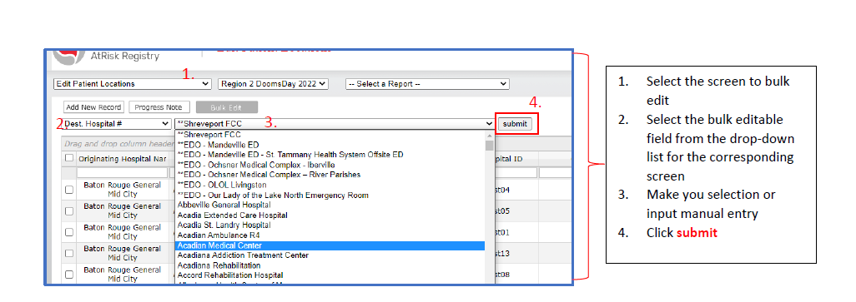
In-State Patient Movement –Bulk Editing
A “bulk edit” feature exists so that hospitals can easily edit groups of patients based on specific criteria. This feature should replace the need for hospitals to continuously upload a revised patient template.

Slide 14
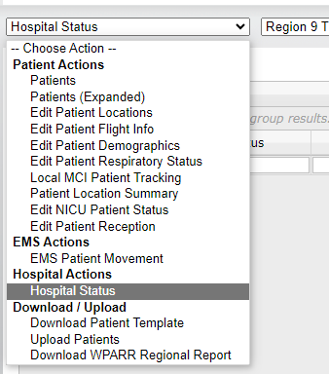
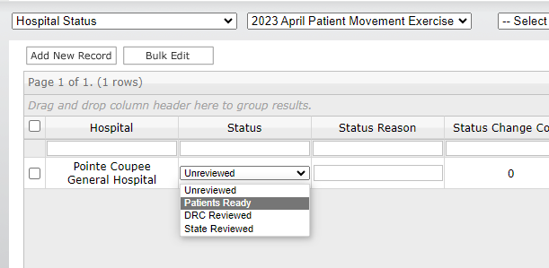
Confirming Patient Lists are Complete
Hospitals have two options for indicating uploads of patients are complete:
Use the the Hospital Actions screen
using the Hospital Status view, select “Patients Ready”
Notify the DRC uploads are complete, meaning admissions have ceased and discharges and transfers are finalized in preparation for sheltering-in-place.
Notes:
Goal: include “Uploads Complete” and swap out “Patient Ready” → if/when added to ARR

Slide 15
Federal/Out of State Movement Specifications
Applies to: Execution of the State-Federal ESF-8 Medical Institution Evacuation Plan (MIEP)
Movement though National Disaster Medical System (NDMS)
Using Department of Defense (DoD) assets
Using Federal air EMS contract assets

Slide 16
Disposition Definitions: Aligns with Attachment C of the User Guide
MIEP Evac – non-critical patients needing evacuation using federal resources, most likely Department of Defense aircraft and teams.
Excludes NICU and Psychiatric patients
patient clinical information should be cross walked against Attachment B to assist flight surgeon with identifying contraindications
Any contraindications may prompt a critical designation and movement by JPATS
JPATS Evac – critical patients being moved by federal EMS contract aircraft and crew.
Hospital primary responsibility to assign JPATS Evac
DRC and State review may prompt patients move from MIEP Evac to JPATS Evac
Federal patient movement cell may determine a patient should be moved to JPATS evac status
Notes:
We’ll need to update this after Friday’s workshop to make sure it’s consistent and what we’ve all decided on. Will align with what’s in updated Attachment B. Need to include what screen(s) these options appear on – should be included in previous slide.

Slide 17
Confirming Patient Lists are Complete
Hospitals will signal they have completed the uploads and patient validation and manifesting for federal movement can begin when conducting this step.
Use the the Hospital Actions screen
→ using the Hospital Status view, select “Patients Ready”
Notes:
Goal: include “Uploads Complete” and swap out “Patient Ready” → if/when added to ARR

Slide 18
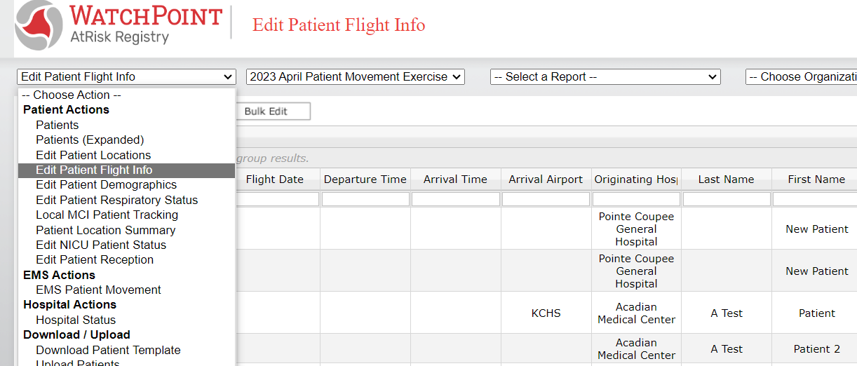
Federal Movement (MIEP & JPATS) Flight Assignments
Hospitals can use the “Edit Patient Flight Info” screen to see flight details after the patient lists have been reviewed by the federal movement team and manifests are set.
The following key information may be provided and updated on this view:
Flight departure airport
Flight time
Tail Number
Arrival Airport

Slide 19
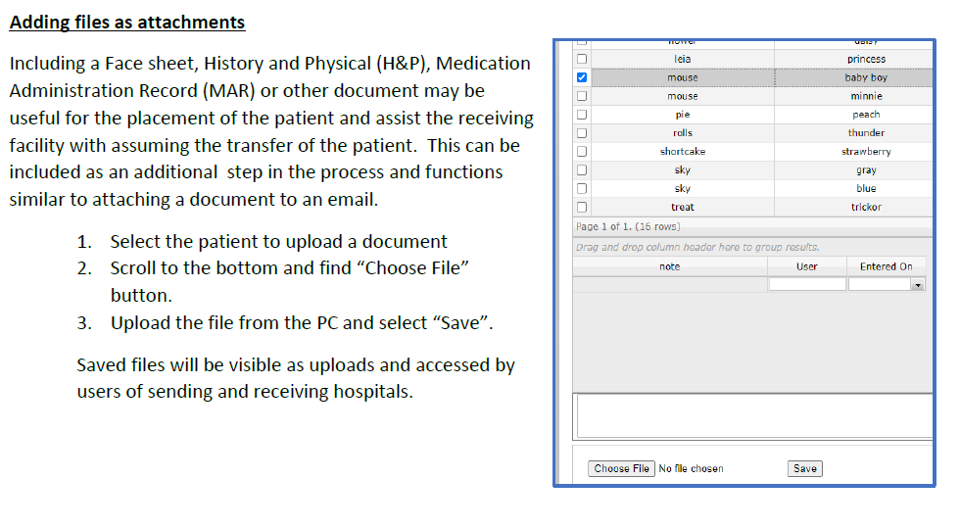
Best Practices!

Slide 20
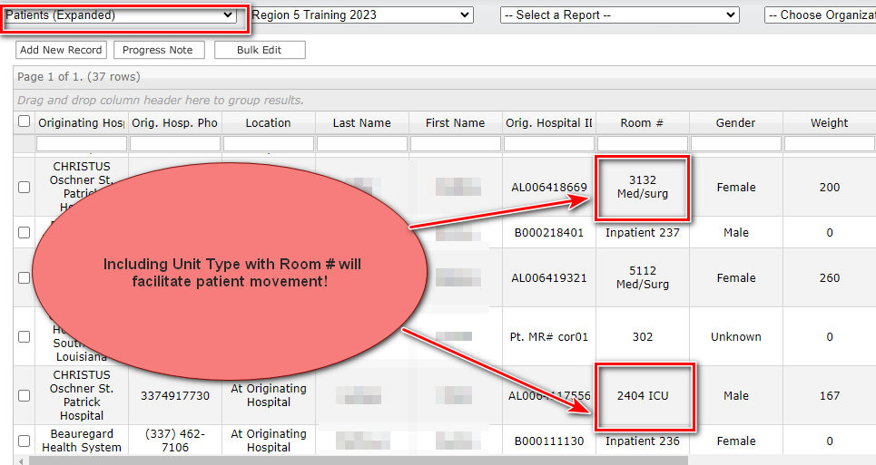
Best Practices – Correct input of Room # information!
Please work with your IT and/or patient tracking coordinator(s) to include the following information in the “Room #” Field:

Slide 21
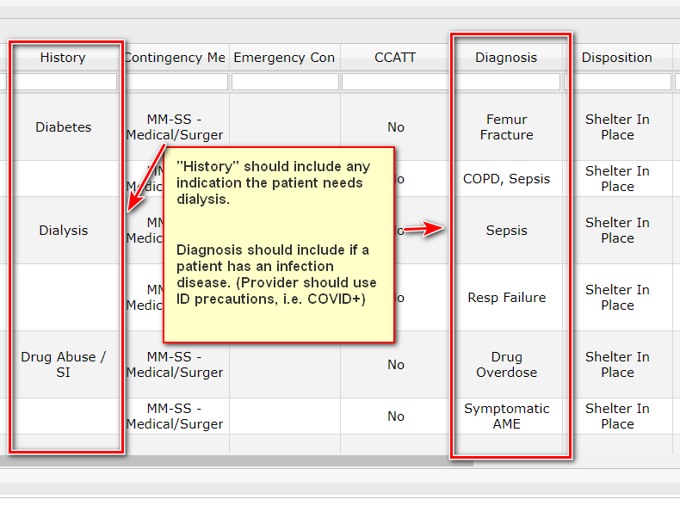
Best Practices – Good clinical details!
Please work with your IT to include the following information in the “History”/ “Diagnosis” Fields:

